Slide 1
Algorithm Analysis

Slide 2
In this chapter
The concept of a growth rate, the rate at which the cost of an algorithm grows as the size of its input grows;
The concept of upper and lower bounds for a growth rate, and how to estimate these bounds for a simple program, algorithm, or problem;
The difference between the cost of an algorithm ( or program ) and the cost of a problem

Slide 3
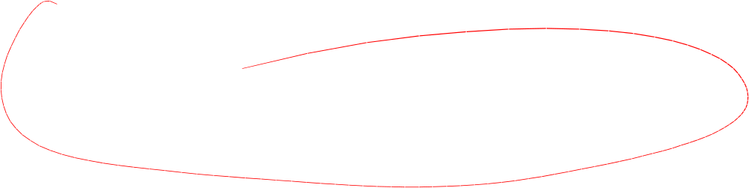
Algorithm Efficiency
There are often many approaches (algorithms) to solve a problem. How do we choose between them?
At the heart of computer program design there are two (sometimes conflicting) goals.
  To design an algorithm that is easy to understand, code, debug.
  To design an algorithm that makes efficient use of the computer’s resources.

Slide 4
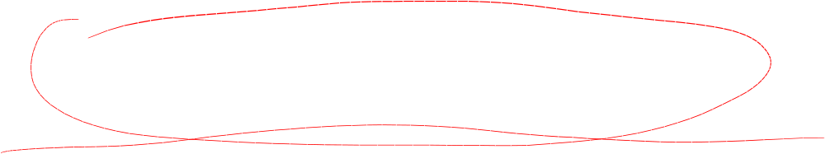
Algorithm Efficiency (cont)
Goal (1) is the concern of Software Engineering.
Goal (2) is the concern of data structures and algorithm analysis.
When goal (2) is important, how do we measure an algorithm’s cost?

Slide 5

How to Measure Efficiency?
Empirical comparison (run programs 实证比较)
Asymptotic Algorithm Analysis (渐进算法分析)
Critical resources (临界资源):
Factors affecting running time (执行时间的影响因素):
For most algorithms, running time depends on “size” of the input.
Running time is expressed as T(n) for some function T on input size n.
Notes:
Empirical comparison is difficult to do “fairly” and is time consuming.
Critical resources: Time. Space (disk, RAM). Programmers effort. Ease of use (user’s effort).
Factors affecting running time: Machine load. OS. Compiler. Problem size. Specific input values for given problem size.

Slide 6
How to Measure Efficiency? (cont)
Of primary consideration when estimation an algorithm’s performance is the number of basic operations required by the algorithm to process an input of a certain size.
  Basic operations 完成该操作所需时间与操作数的具体取值无关
  Size 输入
  are both rather vague(含糊，不清楚) and depend on the algorithm being analyzed.

Slide 7
Examples of Growth Rate
Example 1.
// Find largest value
int largest(int array[], int n) {
int currlarge = 0; // Largest value seen
for (int i=1; i<n; i++) // For each val
if (array[currlarge] < array[i])
currlarge = i; // Remember pos
return currlarge; // Return largest
}
T(n) = cn
T(n) 非负值
Notes:
As n grows, how does T(n) grow?
Cost: T(n) = c₁n + c₂ steps

Slide 8
Examples (cont)
Example 2: Assignment statement.
T(n) = c₁
Example 3:
sum = 0;
for (i=1; i<=n; i++)
for (j=1; j<n; j++)
sum++;
}
T(n) = c₂ n²
Notes:
Example 2: Constant cost.
Example 3: Cost: T(n) = c₁n² + c². Roughly n² steps, with sum being n² at the end. Ignore various overhead such as loop counter increments.

Slide 9
glossary
growth rate 输入的值增长时，算法代价的增长速率
linear growth rate / linear time cost
quadratic growth rate
exponential growth rate

Slide 10
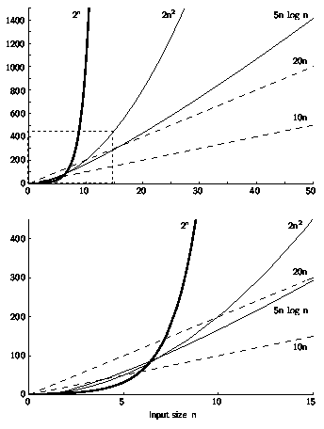
Growth Rate Graph

Slide 11
Best, Worst, Average Cases
Not all inputs of a given size take the same time to run.
Sequential search for K in an array of n integers:
  Begin at first element in array and look at each element in turn until K is found
Best case: Find at first position. Cost is 1 compare
Worst case: Find at last position. Cost is n compares
Average case: (n+1)/2 compares
Notes:
Best: Find at first position. Cost is 1 compare.
Worst: Find at last position. Cost is n compares.
Average: (n+1)/2 compares IF we assume the element with value K is equally likely to be in any position in the array.

Slide 12
Which Analysis to Use?
While average time appears to be the fairest measure, it may be difficult to determine.
When is the worst case time important?
Notes:
Average time analysis requires knowledge of distributions. For example, the assumption of distribution used for average case in the last example.
Worst-case time is important for real-time algorithms.

Slide 13
Faster Computer or Algorithm?
What happens when we buy a computer 10 times faster?
T(n) | n | n’ | Change | n’/n
10n | 1,000 | 10,000 | n’ = 10n | 10
20n | 500 | 5,000 | n’ = 10n | 10
5n log n | 250 | 1,842 | √10 n < n’ < 10n | 7.37
2n² | 70 | 223 | n’ = √10n | 3.16
2^{n} | 13 | 16 | n’ = n + 3 | -----
Notes:
How much speedup? 10 times. More important: How much increase in problem size for same time expended? That depends on the growth rate.
n: Size of input that can be processed in one hour (10,000 steps).
n’: Size of input that can be processed in one our on the new machine (100,000 steps).
Note: for 2^{n}, if n = 1000, then n’ would be 1003.

Slide 14

Asymptotic Analysis: Big-oh
Definition: For T(n) a non-negatively valued function, T(n) is in the set O(f(n)) if there exist two positive constants c and n₀ such that T(n) <= cf(n) for all n > n₀.
Usage: The algorithm is in O(n²) in [best, average, worst] case.
Meaning: For all data sets big enough (i.e., n>n₀), the algorithm always executes in less than cf(n) steps in [best, average, worst] case.
Notes:
Must pick one of [best, average, worst] to complete the statement. Big-oh notation applies to some set of bounds.

Slide 15
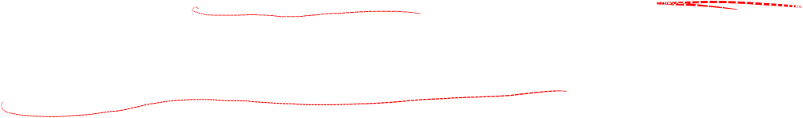
Big-oh Notation (cont)
Big-oh notation indicates an upper bound.
Example: If T(n) = 3n² then T(n) is in O(n²).
Wish tightest upper bound:
While T(n) = 3n² is in O(n³), we prefer O(n²).
Notes:
It provides more information in this example to say O(n²) than O(n³).

Slide 16

Big-Oh Examples
Example 1: Finding value X in an array (average cost).
T(n) = c_{s}n/2.
For all values of n > 1, c_{s}n/2 <= c_{s}n.
Therefore, by the definition, T(n) is in O(n) for n₀ = 1 and c = c_{s}.
Notes:
We are doing average case.
c_{s} is a constant. The actual value is irrelevant.

Slide 17

Big-Oh Examples
Example 2: T(n) = c₁n² + c₂n in average case.
c₁n² + c₂n <= c₁n² + c₂n² <= (c₁ + c₂)n² for all n > 1.
T(n) <= cn² for c = c₁ + c₂ and n₀ = 1.
Therefore, T(n) is in O(n²) by the definition.
Example 3: T(n) = c. We say this is in O(1).

Slide 18
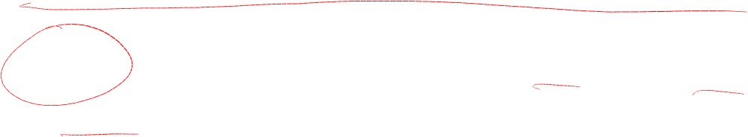
A Common Misunderstanding
“The best case for my algorithm is n=1 because that is the fastest.” WRONG!
Big-oh refers to a growth rate as n grows to ∞.
Best case is defined as which input of size n is cheapest among all inputs of size n.
Notes:
We are doing average case.
c_{s} is a constant. The actual value is irrelevant.

Slide 19
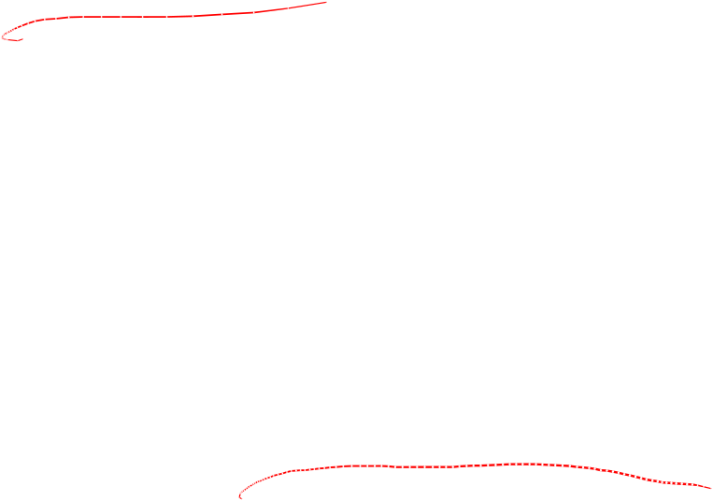
Big-Omega
Definition: For T(n) a non-negatively valued function, T(n) is in the set Ω(g(n)) if there exist two positive constants c and n₀ such that T(n) >= cg(n) for all n > n₀.
Meaning: For all data sets big enough (i.e., n > n₀), the algorithm always executes in more than cg(n) steps.
Lower bound.

Slide 20
Big-Omega Example
T(n) = c₁n² + c₂n.
c₁n² + c₂n >= c₁n² for all n > 1.
T(n) >= cn² for c = c₁ and n₀ = 1.
Therefore, T(n) is in Ω(n²) by the definition.
We want the greatest lower bound.

Slide 21
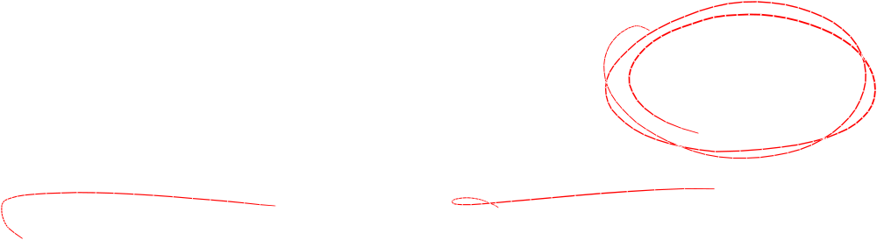
Theta Notation
When big-Oh and Ω meet, we indicate this by using Θ (big-Theta) notation.
Definition: An algorithm is said to be Θ(h(n)) if it is in O(h(n)) and it is in Ω(h(n)).
Notes:
For polynomial equations on T(n), we always have Θ. There is no uncertainty, since once we have the equation, we have a “complete” analysis.

Slide 22
A Common Misunderstanding
Confusing worst case with upper bound.
Upper bound refers to a growth rate.
Worst case refers to the worst input from among the choices for possible inputs of a given size.

Slide 23
Simplifying Rules
If f(n) is in O(g(n)) and g(n) is in O(h(n)), then f(n) is in O(h(n)).
If f(n) is in O(kg(n)) for any constant k > 0, then f(n) is in O(g(n)).
If f₁(n) is in O(g₁(n)) and f₂(n) is in O(g₂(n)), then (f₁ + f₂)(n) is in O(max(g₁(n), g₂(n))).
If f₁(n) is in O(g₁(n)) and f₂(n) is in O(g₂(n)) then f₁(n)f₂(n) is in O(g₁(n)g₂(n)).
Notes:
2. Ignore constants.
3. Drop low order terms.
4. Useful for analyzing loops.

Slide 24
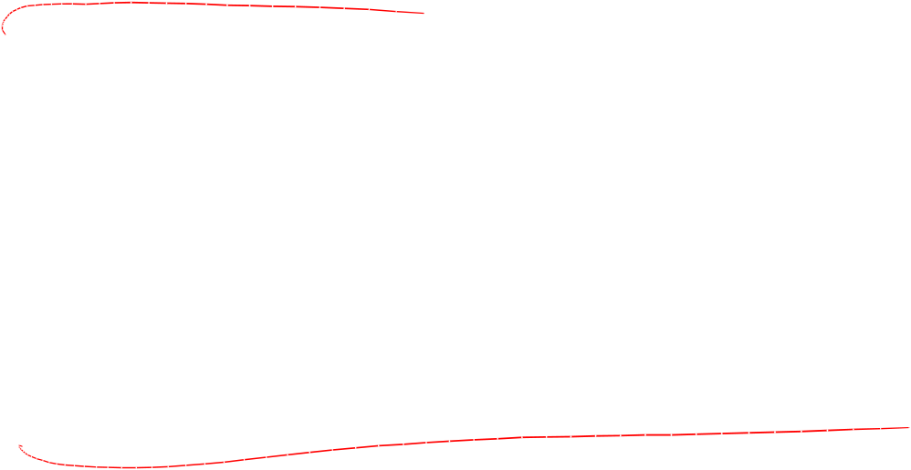
Running Time Examples (1)
Example 1: a = b;
This assignment takes constant time, so it is Θ(1).
Example 2:
sum = 0;
for (i=1; i<=n; i++)
sum += n;
Notes:
Asymptotic analysis is defined for equations. We need to convert programs to equations to analyze them.
The traditional notation is Θ(1), not Θ(c).
Θ(n) even though the value of sum is n².

Slide 25
Running Time Examples (2)
Example 3:
sum = 0;
for (i=1; i<=n; i++)
for (j=1; j<=i; j++)
sum++;
for (k=0; k<n; k++)
A[k] = k;
Notes:
First statement is Θ(1). Double for loop is Σi = Θ(n²). Final for loop is Θ(n). Result: Θ(n²).

Slide 26
Running Time Examples (3)
Example 4:
sum1 = 0;
for (i=1; i<=n; i++)
for (j=1; j<=n; j++)
sum1++;
sum2 = 0;
for (i=1; i<=n; i++)
for (j=1; j<=i; j++)
sum2++;
Notes:
First loop, sum is n². Second loop, sum is (n+1)(n)/2. Both are Θ(n²).

Slide 27

Running Time Examples (4)
Example 5:
sum1 = 0;
for (k=1; k<=n; k*=2)
for (j=1; j<=n; j++)
sum1++;
sum2 = 0;
for (k=1; k<=n; k*=2)
for (j=1; j<=k; j++)
sum2++;
Notes:
First loop is Σn for k = 1 to log n, or Θ(n log n).
Second loop is Σ2^{k} for k = 0 to log n - 1, or Θ(n).

Slide 28
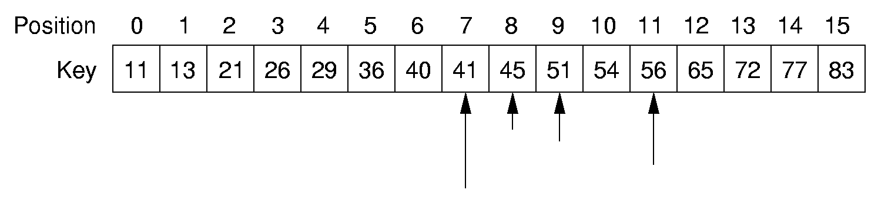
Binary Search
How many elements are examined in worst case?

Slide 29
Binary Search
// Return position of element in sorted
// array of size n with value K.
int binary(int array[], int n, int K) {
int l = -1;
int r = n; // l, r are beyond array bounds
while (l+1 != r) { // Stop when l, r meet
int i = (l+r)/2; // Check middle
if (K < array[i]) r = i; // Left half
if (K == array[i]) return i; // Found it
if (K > array[i]) l = i; // Right half
}
return n; // Search value not in array
}

Slide 30
Other Control Statements
while loop: Analyze like a for loop.
if statement: Take greater complexity of then/else clauses.
switch statement: Take complexity of most expensive case.
Subroutine call: Complexity of the subroutine.
Notes:
if statement: The probabilities for the then/else clauses being executed must be independent of n.
switch statement: The probabilities of the various clauses being executed must be independent of n.

Slide 31
Analyzing Problems
Upper bound: Upper bound of best known algorithm.
Lower bound: Lower bound for every possible algorithm.
Notes:
Analyzing problems is done a lot in a senior algorithms class.

Slide 32
Analyzing Problems: Example
Common misunderstanding: No distinction between upper/lower bound when you know the exact running time.
Example of imperfect knowledge: Sorting
1. Cost of I/O: Ω(n).
2. Bubble or insertion sort: O(n²).
3. A better sort (Quicksort, Mergesort, Heapsort, etc.): O(n log n).
4. We prove later that sorting is Ω(n log n).
Notes:
The examples so far have been easy in that exact equations always yield Θ. Thus, it is hard to distinguish Ω and O. This example should help to explain the difference. Bounds are used to describe our level of uncertainty about an algorithm.

Slide 33
Multiple Parameters
Compute the rank ordering for all C pixel values in a picture of P pixels.
for (i=0; i<C; i++) // Initialize count
count[i] = 0;
for (i=0; i<P; i++) // Look at all pixels
count[value(i)]++; // Increment count
sort(count); // Sort pixel counts
If we use P as the measure, then time is Θ(P).
More accurate is Θ(P + C log C).
Notes:
Example picture size: 256 colors (8 bits), 1000 by 1000 pixels.

Slide 34
Space Bounds
Space bounds can also be analyzed with asymptotic complexity analysis.
Time: Algorithm
Space: Data Structure

Slide 35
Space/Time Tradeoff Principle
One can often reduce time if one is willing to sacrifice space, or vice versa.
  Encoding or packing information
    Boolean flags
  Table lookup
    Factorials
Disk-based Space/Time Tradeoff Principle: The smaller you make the disk storage requirements, the faster your program will run.

Slide 36
C++ 类模板学习

Slide 37
课件上形如： template <模板参数表> class 类名 类体
1.定义语法:
    template <模板参数表> class 类名 类体
    注:
    模板类型参数 typename id
    模板非类型参数 例如: int n
    类体中可以出现的类型有
      a. 基本数据类型 b. 用户自定义类型 c. 模板类型参数 d. 类名

Slide 38
2.模板实例化
    (1)从类模板生成具体类的过程
    (2)时机:定义对象时; 指针或者引用解引用(*p)时;
    (3)语法:
    类模板名<实参表>

Slide 39
示例
Node <int> x;
Node <double> *p;//注意,此时不会实例化模板
示例程序:stack模板
#include "stdafx.h"
#include <iostream>
using namespace std;
template <typename T> class Stack;

Slide 40
template <typename T> class StackItem
{
public:
T info;
StackItem *next;
StackItem(T x)
{
//cout << "StackItem constructor" << endl;
info = x;
next = NULL;
}
friend class Stack<T>;
};

Slide 41
template <typename T> class Stack
{
StackItem<T> * top;
public:
Stack()
{
//cout << "Stack constructor" << endl;
top = NULL;
}
void push(T x)
{
StackItem<T> *p = new StackItem<T>(x);
p->next = top;
top = p;
}
T pop()
{
if(top == NULL)
{
throw 1;
}
StackItem<T> * p = top;
top = top->next;
T x = p->info;
delete p;
return x;
}
};
void main()
{
Stack<double> a;
a.push(1.3);
a.push(9);
cout << a.pop() << endl;
cout << a.pop() << endl;
}

